Slide 1
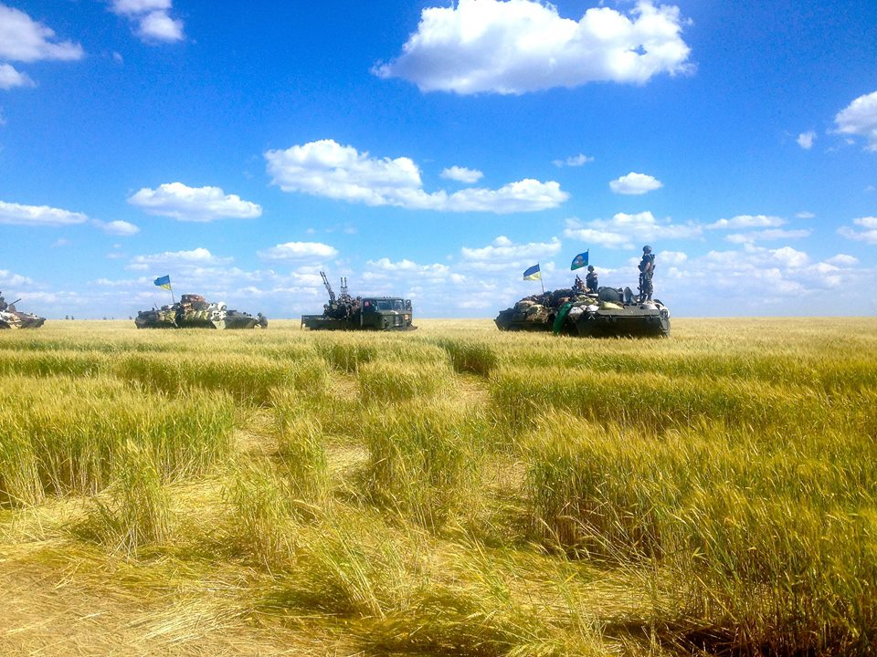

Ukrainian agriculture under war conditions: disruptions, coping strategies and lessons learned
Dr. Larysa STARIKOVA
PO ‘Analysis Centre of
Agrarian Union of Ukraine’

Slide 2

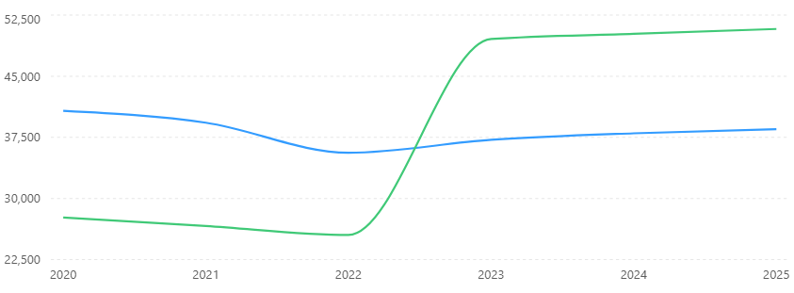
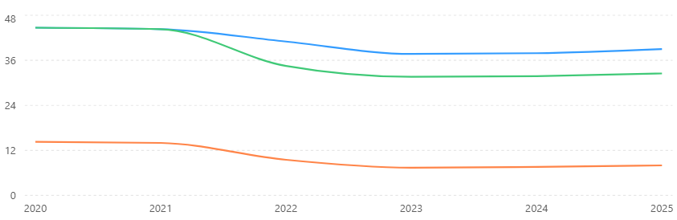
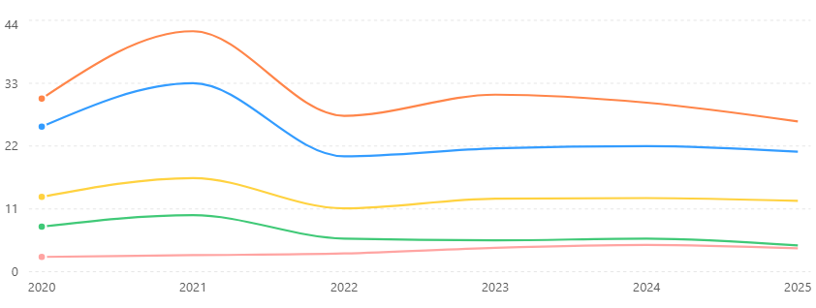
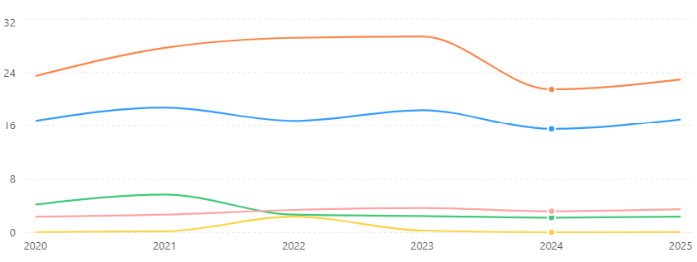
Disruptions
Number of agrarian producers
farmers
Population of Ukraine, mln
middle&big
general
controlled area
Land banks of agrarian producers
rural
Land bank size | >15 000 га | 500–15 000 га | <500 га
Changes, % of the total | ~12% → ~17% | ~38% → ~42% | ~50% → ~41%
Agrarian production, mln ton
Agrarian export, mln ton
corn
wheat
barley
sunflower
rapeseed

Slide 3
Coping strategies → operational level
Land: | Demining Consolidation | Demining system, state managed, €400mln, certified operators, €1000/h Silent, land market 10 000h, mortgage, racketeering, accounting lease as intangible assets
Assets: | Real estate Equipment | Assurance, Act 28.11.2025 on compensations via Export Credit Agency 25–40% compensation for machinery, processing up to €160 000 New facilities, recovery (2026) up to €320 000
Technology disruptions: | Inputs/Outputs Loss of assets Redundant assets Relocation Electricity Logistics Workforce | Availability/Price (milk 2026) Fragmentation Sailing/Lease Equipment/Technique, local support with resources Additional expenditures Additional expenditures, EU solidarity lanes Reservation, common approach, €400→€500

Slide 4
Coping strategies → in question
 | Profit, € mln
2020 | 801,94
2021 | 1 504,85
2022 | 479,61
2023 | 1 679,61
2024 | 2 013,59
2025 | 2 462,13
April 2026 | 504,85
National banking system
Finance: | Program 5-7-9 Return of credits | State compensation for banking rate Irresponsible attitude, ignoring war circumstances, breaching law, ruining credit histories
 | Number of Entities → 40 000
 | 5-7-9 | total | %
01.06.2026 | 4 955 | 8 677 | 57,10%
25.05.2026 | 4 450 | 8 387 | 53,06%
31.12.2025 | 7 978 | 15 574 | 51,23%
01.06.2025 | 3 965 | 8 624 | 45,98%
 | Credits, € mln
 | 5-7-9 | total | %
01.06.2026 | 597,6249 | 1 321,134 | 45,24%
25.05.2026 | 568,191 | 1 255,565 | 45,25%
31.12.2025 | 1 043,708 | 2 552,797 | 40,88%
01.06.2025 | 473,8122 | 1 060,721 | 44,67%
 | State guaranteed credits (portfolio) € mln
 | total | 80% | % | less than 80% | %
01.06.2026 | 311,97 | 68,60 | 21,99% | 243,36 | 78,01%
25.05.2026 | 297,90 | 67,82 | 22,77% | 230,08 | 77,23%
31.12.2025 | 557,49 | 119,47 | 21,43% | 438,01 | 78,57%
01.06.2025 | 264,83 | 68,66 | 25,93% | 196,17 | 74,07%
Ukraine Facility €7bln | ‘market rate’ up to 30%, GUF experience, 2015, 5-7-9
State financial support €272mln (2026) is distributed in a clear, transparent way (ministry orders)
State donated assurance | the law of 2012 implementation not reviewed, situation turned into the mess, since 2020
Hybrid influence
Soybean export duty | ‘processing’, dull procedure, summer 2025, lost € 57,5 mln during September-December 2025
Traceability | the last attempt, stopping logistics

Slide 5
Resilience
 | Robustness | Adaptability | Transformability | Long term
Farm | 2022–2025, stand still | figures, evidence | relocation | best practices capitalization
Specific crops | yes, no changes | yes (soy) | bought innovations | bought innovations
Up/Downstream | no robustness | yes (‘market arm’) | ‘market arm’ | optimization
Climate change | no official data | land clearing | in question, finances | EU approach
Market volatility | enough | traditional | traditional | traditional
Policy | yes, no changes | no | EU integration, slow | EU integration, digital

Slide 6
Lessons learned
(?) State management is to be transformed from operational to the strategic level
(?) Financial system is to be bring to realities, financial markets harmonized and open
(?) EU support for the after-war reconstruction is to be crucially revised
(?) Hybrid influence in policy making and legislation is to be indicated
Ukraine has a system for the land demining and clearing
Agrarian sector is just the only sector distributing state budget costs in a clear way
Agrarian sector of Ukraine appeared resilient enough but land banks are enlarging
Digitalization in agrarian sphere give a hope for a fast and successful EU integration

